Slide 1

Analysis of Top Instagram Influencers
Understanding the Impact on a Global Scale
Samuel Muigai

Slide 2
Content
Introduction
Dataset Overview
Key Findings
Visualizations
Business Recommendations
Future Work
Conclusion

Slide 3

Introduction
Greetings and welcome to an analysis of the top Instagram influencers as at 2022.
We will examine the worldwide influence of these influencers and their relationship with the global population.

Slide 4
Dataset Overview
We utilized two datasets: one containing information about top Instagram influencers as at the year 2022, and another one providing data on world population.
These datasets were then merged and carefully cleaned for our analysis

Slide 5
Key Findings
1. Global Distribution of Followers
Our analysis revealed a diverse global distribution of followers, with countries like United States and Spain leading in total followers.
The distribution of followers across countries is highly diverse, showcasing the global appeal and reach of top Instagram influencers.

Slide 6
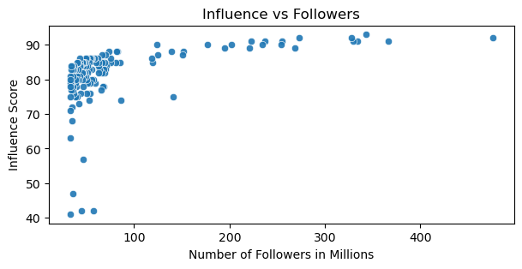
2. Effect of Number of Followers on Influence
Followers with more followers have a higher influence score, and therefore have more impact

Slide 7
2. Strategic Opportunities in High-Population Countries
Identifying influencers from high-population countries such as the United States presents strategic opportunities for brands to tap into broader audience demographics.
Collaborations with influencers from these countries may offer significant reach and impact.

Slide 8
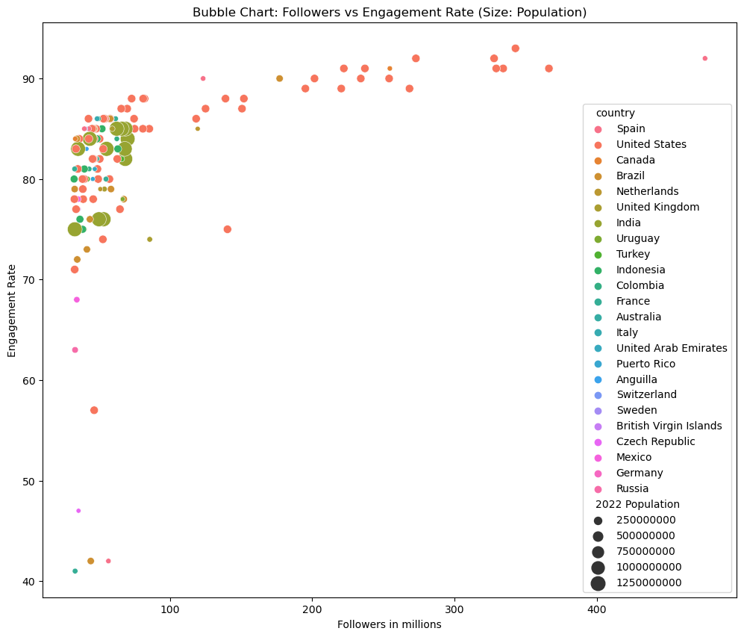

Slide 9
3. Correlation Analysis
The correlation matrix heatmap unveiled interesting relationships between key variables—followers, engagement rates, and population
Positive correlations between followers and the influence score suggest that influencers with larger followings tend to have higher influence.

Slide 10
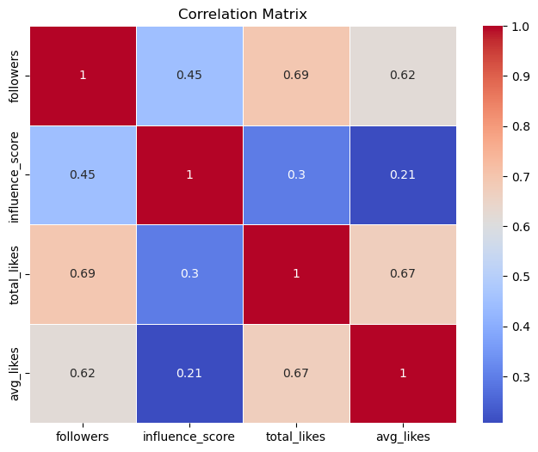

Slide 11
Business Recommendations
1. Strategic Collaborations
Consider strategic collaborations with influencers from high-population countries, leveraging their potential for broader reach and impact. Such countries include Spain.
2.Targeted Collaboration Strategies
Develop targeted collaboration strategies with influencers based on their influence score, and not likes.

Slide 12
Future Works
To further enhance the analysis and explore additional dimensions, the following areas can be considered for future work:
Conduct sentiment analysis on influencer posts to understand the sentiment of audience interactions
Develop machine learning models to predict future trends in influencer popularity.
Implement geospatial analysis techniques for a more detailed examination of influencers' impact on specific regions.

Slide 13
Conclusion
In conclusion, the data given today provides us with practical insights to effectively navigate the always evolving field of influencer marketing on a worldwide level. By effectively using these valuable information, businesses can establish significant connections with varied audiences and catapult their brands to unprecedented success in the ever-changing realm of social media.

Slide 14
Thank you!
If you have any further questions or inquiries, please feel free to reach out.

